Slide 1
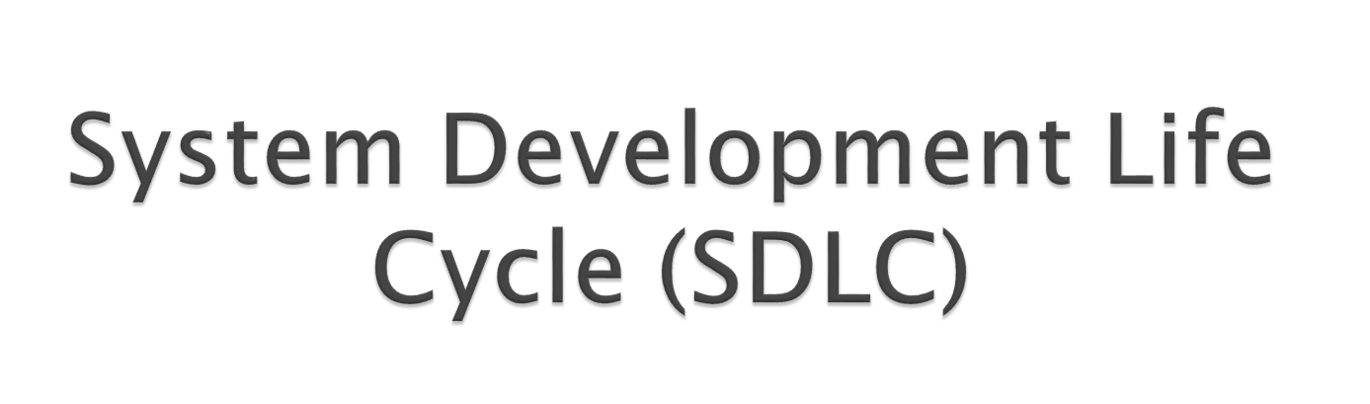

Slide 2

A framework that describes the activities performed at each stage of a software development project

Slide 3
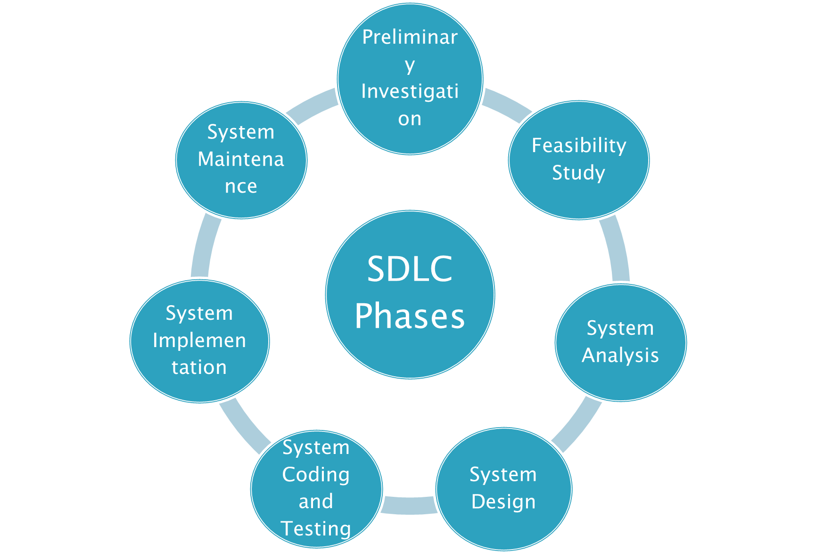

Slide 4

Tasks
What is the problem
Determine if a new system is needed
Whether an alternative system will solve the problem
Results
Need for improving the existing system is recognised

Slide 5

Tasks
Evaluate alternatives based upon
Economic Feasibility
Technical Feasibility
Operational Feasibility
Social Feasibility

Slide 6

Tasks
Detailed study of various operations performed by the system
Studying the existing organisational history, structure, and culture
Define boundaries of the proposed system
Data collection or data gathering

Slide 7

Tools
Data flow diagrams
Interviews
Onsite observations
Questionnaires
Data dictionaries

Slide 8

Results
SRS (Software Requirement Specification) document is finalised which includes:
Functional and non-functional requirements
What the system will do and what it is not expected to do
Information about other systems with which system must interface

Slide 9

Most creative and challenging phase
Translates the performance requirements into design specifications
Tasks
How should the problem be solved
Organisational and job designs prepared
Information processing systems design
Design of the database
Design of the user interface
Physical design
Input data and master files are designed
Output formats are designed

Slide 10

Results
Detailed System Document
Procedural flowcharts
Record layouts
Report layouts
Workable plan for implementing proposed system

Slide 11

Build the system to the design specifications
Develop the software
Acquire the hardware
Test the system for acceptance
Program Testing (Unit testing)
System Testing
User Acceptance Testing
Quality Assurance Testing

Slide 12

Convert from old system to new system
Compile final documentation
Evaluate the new system

Slide 13

Types of Conversion
Direct/plunge/crash approach-entire new system completely replaces entire old system, in one step
Parallel approach-both systems are operated side by side until the new system proves itself
Pilot approach-launched new system for only one group within the business
Phased/incremental approach-individual parts of new system are gradually phased-in over time

Slide 14


Keeping everything running

Slide 15

Types of Maintenance
Correction of new bugs found (corrective)
System adjustments to environmental changes and users’ changing needs (adaptive)
Enhancing the performance, changes to use better techniques when they become available (perfective)
Preventative maintenance

